Slide 1
Prediction model by the utilization of distinctive features of patients with thyroid disease
Submitted By: Submitted To :
Saathyak Rao Kasuganti Professor Masoud Soroush

Slide 2
TOPIC : Prediction model by the utilization of distinctive features of patients with thyroid disease
Gain insights and develop a prediction model by the utilization of distinctive features of patients with thyroid disease.
Use of historical medical records that show a relation with thyroid disease.
Looking the relationship with the distinct features of the data set we are going to be able to identify, predict and classify data from the chosen dataset.By applying a range of classification and regression algorithms.
This dataset contains both continuous and categorical variables and we are planning to have models able to adapt to different changes from the dataset.
Source of Data: Keel Machine Learning Repository - Thyroid dataset.

Slide 3
Introduction
The thyroid is a gland through the production and release of thyroid hormones, it regulates many automatic processes in your body.
These include Breathing,Heart rate,Energy production Muscle strength,Body temperature,Weight etc.
The incidence of thyroid disease, and its effects
Over 12% of Americans will experience a thyroid problem at some point in their lives.
• Thyroid disease affects 20 million Americans, according to estimates.
• Up to 60% of thyroid disease sufferers are ignorant of their illness.
• Thyroid issues are five to eight times more common in women than in men.
• Thyroid disorders affect one in every eight person throughout the course of their lifetimes.

Slide 4
Data Description
The dataset is in “.dat” file format and size of the dataset is 635 KB.The dataset has 7200 rows of data, with 21 columns or features. Out of 21 columns 6 continuous variables and 15 categorical variables.
Main 6 variable are :
T4 - Thyroxine(tetraiodothyronine), is the main hormone our thyroid gland releases into our bloodstream.
TSH - Thyroid Stimulating Hormone : Thyroid stimulating hormone also known as thyrotropin is a hormone that controls the way other hormones function. Basically it stimulates the production two main T4 & T3
T3 - Triiodothyronine : A thyroid hormone is triiodothyronine (T3). It is crucial for the body's regulation of metabolism (the many processes that control the rate of activity in cells and tissues).
TT4 -Total Thyroxine
FTI- Free Thyroid Index : Free thyroxine index is considered to be a reliable indicator of thyroid status in the presence of abnormalities in plasma protein binding.
T4U - Thyroxine Utilization Rate.

Slide 5
Problem Statements
Problem 1: Regression Problem
Target Audience / Beneficiary: Medical testing facilities & labs.
Aim : Find the missing values in medical report
Target Variable : To find the value of TT4 (Total thyroxine) by using other variables such asT3, T4 and TSH.
Benefits :
Validating the existing medical data to check for possible errors or outliers in medical reports.
Use of regression to predict and generate the total thyroxine level in blood using the other variables

Slide 6
Problem 2 : Classification Algorithm
Target Audience / Beneficiary: End users - Patients
Aim : To use classification algorithms for Classify the patients into 3 classes based on the thyroid medical data set.
Target Classes:
“0” - Hyperthyroidism : Hyperthyroidism is an overactive thyroid (when it produces too much thyroid hormone).
“1” - HypoThyroidism : Hypothyroidism is an underactive thyroid (when it does not produce enough). Almost 4.6% of US population is suffering from it.
“2” - Negative.

Slide 7
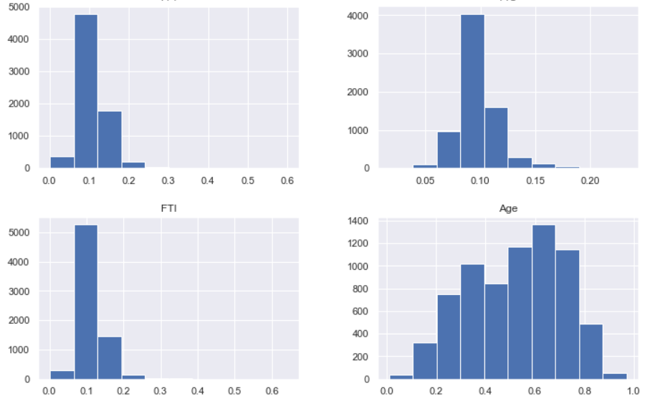
EDA conducted
Label Encoding
The target variable in the in the data is divided into three classes 1,2,3.
In order to run the classification algorithm we are using label_encoder.
Classes 1,2,3 were renamed as 0,1,2 respectively.
Distribution
Distribution is presented
The results of this histogram
show a normal distribution.

Slide 8
EDA: Pre-processing and Understanding the data
Null Values: No null values were present in the data
Handling Duplicates: The data frame parameters before deduplication was of (7200, 22) and after dropping the duplicates was (7129,22).
Identifying if the data-set is balanced or unbalanced:
The number of samples with Hyper-thyroidism = 166
The number of samples with Hypo-thyroidism = 368
The number of samples with Negative case of Thyroidism = 6666
The results show that the data is close to an unbalanced classification problem.

Slide 9
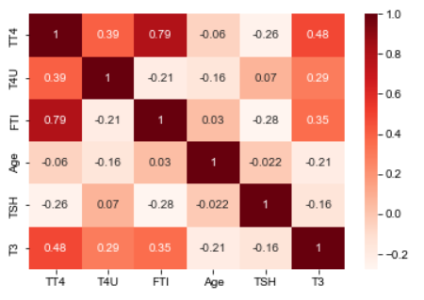
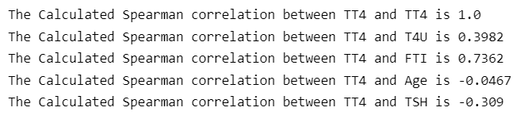
Correlation : Identification of the Input features for the regression problem:
The values of FTI, T3 and T4U have high correlation with TT4 (Total Thyroxine Values)
Therefore are selected as input variables for regression analysis.

Slide 10
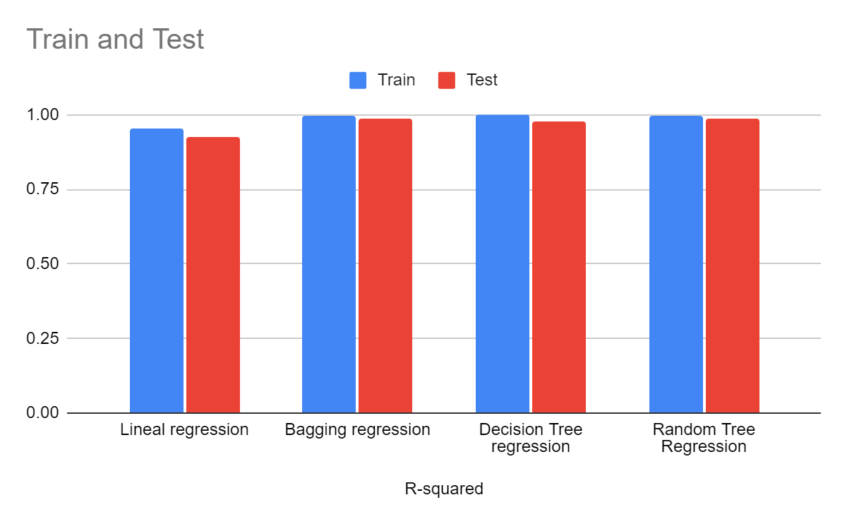
Regression
Linear regression
R^2 score for train dataset = 0.9517
R^2 score for test dataset = 0.9267
Bagging regression
R^2 score for train dataset = 0.9959
R^2 score for test dataset = 0.9882
Decision Tree
R^2 score for train dataset = 0.9999
R^2 score for test dataset = 0.9777
Random Tree regression
R^2 score for train dataset = 0.9958
R^2 score for test dataset = 0.9854

Slide 11
Advantages and disadvantages between regression conducted
Simple Linear Regression: Some advantages that were taken into account when working with simple linear regression was its availability. The implementation of linear regression can be easy to interpret, efficient to train and very enriching (gives an accurate perspective of the results). Also it handles overfitting by using dimensionality reduction techniques, regularization and cross validation, and is good with extrapolation. However it has some disadvantages, it is prone to noise, is quite sensitive to outliers and is prone to multicollinearity.
Bagging regression: It provides stability and increases the machine learning algorithms accuracy that is used in statistical classification and regression. It helps in reducing variance, which avoids overfitting. Some disadvantages that we took into consideration are that it may result in high bias if it is not modelled properly resulting in underfitting.

Slide 12
Decision Tree regression : Some advantages are that It can be used for both classification and regression problems and it can capture nonlinear relationships. Also, is simple and it is non-parametric. In the other hand some disadvantages include the fact that its complexity increases as the model increases, overfitting and reusability.
Random Forest regression: Some advantages include that it can be used for categorical and numerical data, implicitly perform feature selection and generate uncorrelated decision trees. Also, it can handle linear and nonlinear regression. Some disadvantages include, there are not easy to interpret, and there not a lot of control over the model.

Slide 13
Classification
The algorithms that we used to find insights from the given data:
Decision Tree
Adaboost
Gradient Boosting
Random Forest

Slide 14
Why These Algorithms?
Decision Tree : The main advantage of the decision tree classifier is its ability to use different feature subsets and decision rules at different stages of classification.
Adaboost : is a meta-estimator that begins by fitting a classifier on the original dataset and then fits additional copies of the classifier on the same dataset but where the weights of incorrectly classified instances are adjusted such that subsequent classifiers focus more on difficult cases.
Gradient Boosting : It is a technique of producing an additive predictive model by combining various weak predictors
.
Random Forest: it produces good predictions that can be understood easily. It can handle large datasets efficiently. The random forest algorithm provides a higher level of accuracy in predicting outcomes over the decision tree algorithm

Slide 15
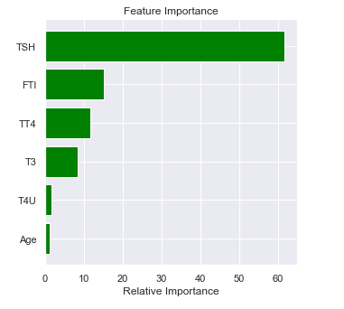
Feature Selection:
After comparing the results using the entire feature set and important features,
The best results - overall were achieved by using the top-3 important features.

Slide 16
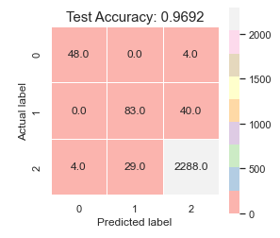
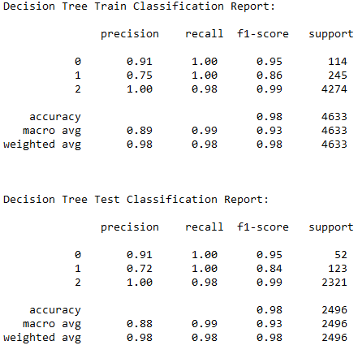
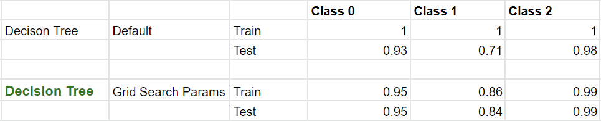
Room For Improvements
Firstly, while working with decision trees we can observe that the train data has been classified really well compared to the test data. So, we then applied Grid Search CV to Decision Tree and have achieved a better result.

Slide 17
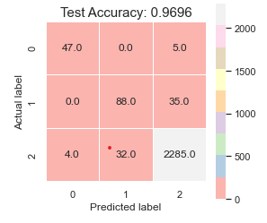
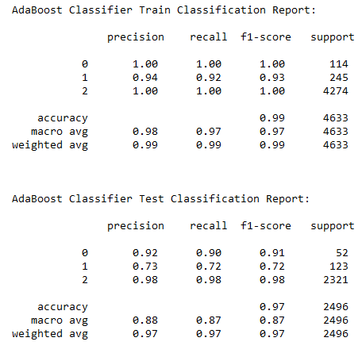
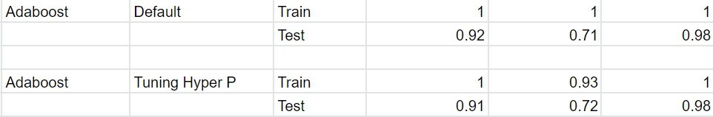
Similarly, For Adaboosting we initially found out that the output of the data has high bias after which we have tried tuning the hyper parameters and have obtained better results.

Slide 18
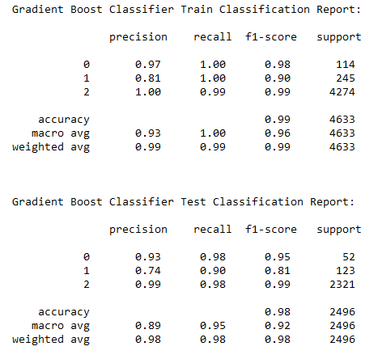
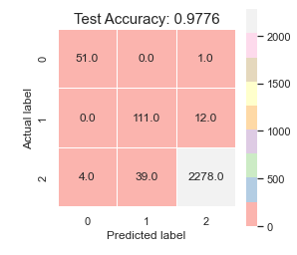
Then, while working with Gradient Boosting we directly tuned the hyperparameters and achieved better results.

Slide 19
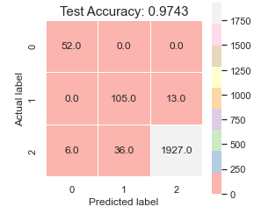
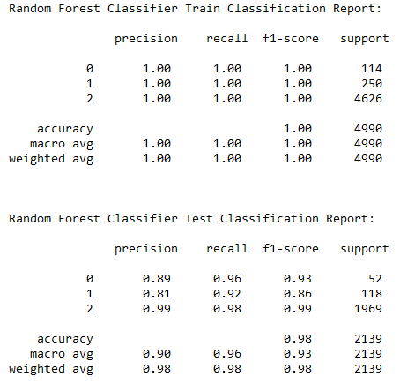
Finally, While working on Random Forest Algorithm the results were quite different from the rest after tuning the hyperparameters. The output of the data was a lot better and the test data also could classify thyroid for each class much better.

Slide 20
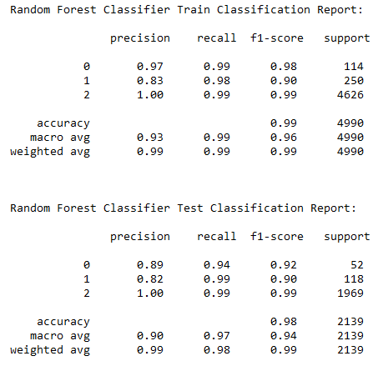
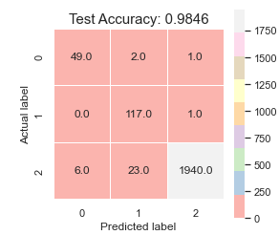
So, Random Forest is the best algorithm for the dataset for classifying whether a patient is suffering from hyperthyroid, hypothyroid or isn’t affected by thyroid at all for it being able to perceive the best outcome as it avoids and prevents overfitting by using multiple trees and its randomized selection of feature makes it more accurate than any decision tree.

Slide 21
The curious case of SVM :
Among the classification algorithms, the first one we used was SVM with default parameters.
Resulted in an f-1 score of 0,0 for the two minority classes.
Did we pick the wrong dataset ? Is the data-set too unbalanced for the algorithms to classify accurately ?
Then, manual tuning of hyper parameters - resulted in f1 score of 74 for the first minority class (o).
However, minority class (1) still had f-1 score 0.
Then used Scikit-learn’s GridSearchCV.
Grid search was able to improve the score of the second minority class from zero to 70 !
That too with minimal variance.

Slide 22
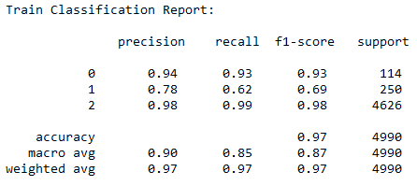
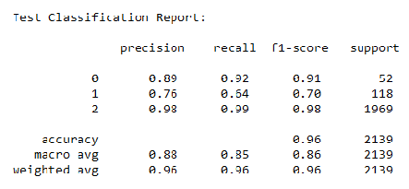
The curious case of SVM :

Slide 23
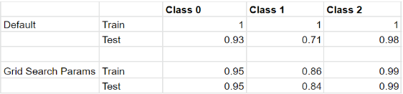
Tackling challenges: The power of Grid Search !
Find the best possible configuration for the models training.
Retain better control over the training process.
Control what the model can and cannot learn.
Greatly able in improve the performance of SVM and Decision Trees.
In case of SVM - f1 score of minority class ‘1’ from 0 to 70 !
In case of Decision trees - able to improve performance and greatly decrease the high variance problem:

Slide 24
Conclusion:
The regression problem was very successful, in being able to predict the target variable with upto 98.8% accuracy.
In case of classification algorithms performance. Random forests, with tuning the hyper-parameters shows the greatest improvement in the result.
Accuracy of 90% and 92% for the minority classes.
Overall accuracy of the model stands at 98.5%
Random forests - Collective outcome of multiple decision trees.
Prevention of overfit for better model performance.
Great with higher dimensional data. (6 features originally)
Ability to handle outliers - binning.
Reducing error - by downsampling majority class and growing trees on balanced dataset

Slide 25
Limitations for much higher accuracy
Highly unbalanced dataset
40:2:1 approximate proportion of classes.
Only 166 instances of minority class out of 7200 rows of data.
Overlap of data - (Low TSH = Low TT4 ?)
External factors that affect the functioning of a normal thyroid gland.
Effect is highly variable for individuals based on:
Sick
Pregnancy
Infections
Goitre
Any tumors
Medication- Steroids and immunosuppressants.
Medical conditions with other glands.

Slide 26
Learning and suggestions:
Grid search is an amazing tool, use it. Saves time and prevents monotony.
Choose algorithms based on the data you use.
Try solving the problem with the simplest algorithms and gradually increase complexity.
What is the best model - Consider two critical factors ?
Obviously, consider the results and metrics.
Also consider how important the accuracy is, what difference does an improvement of 0.1% make ?
Specifically in-case of highly imbalanced classification problems, consider the minority classes.
Highly imbalanced case - overall accuracy has very less weightage compared to the individual accuracies of the minority classes.

